Slide 1

Pediatric Health History
Pediatric Health History-PRACTICAL
Third Stage
Dr. Moustafa Ali Alshammari
Pediatric Nursing

Slide 2
O B J E C T I V E S
1. Define health history
2. Numerate and describe types of Pediatric Health Histories
3. Differentiate between objective and subjective data.
4. Describe Methods of Data Collection.
5. Identify How to Conduct a Pediatric History Interview.

Slide 3
Pediatric Health History
A health history is a collection of subjective data that provides a detailed
profile of the patient’s health status.
Nurses use therapeutic communication skills and interviewing techniques during the health history to establish an effective nurse–patient relationship and to gather data to identify actual and potential health problems.
(continued)

Slide 4
Types of Pediatric Health Histories
Initial (comprehensive) health history:
An initial health care visit requires a comprehensive health history, which creates a database of information for the child who is new to the provider’s practice. The data collected in this history focus not just on past or current illnesses, but also on wellness, health patterns, health knowledge, and activities of daily living (ADL).

Slide 5
Types of Pediatric Health Histories
  Focused (episodic) health history:
  This history is problem-centered, focusing on the present illness or problem. A focused health history is all that is necessary when the child presents with an acute problem or the exacerbation of a chronic condition.

Slide 6
Types of Pediatric Health Histories
Follow-up health history:
  When the child returns to the office after an illness or injury, a follow-up
  history is taken to assess whether the problem is the same, better, or worse.

Slide 7
Types of Pediatric Health Histories
Emergency health history:
An emergency health history involves the quick collection of data in
an acute situation. While this history resembles a focused history, it
needs to be obtained rapidly, usually simultaneously with
interventions, such as the administration of medications or respiratory treatments.

Slide 8
Data Collection
  Subjective data:
  are information perceived only by the affected
  person; these data cannot be perceived or verified by another person.

Slide 9
DATA COLLECTION
Objective data:
are observable and measurable data that can be seen, heard, or felt by someone other than the person experiencing them.

Slide 10
Methods of Data Collection
Observation
  Notes the general appearance and behavior of the client
  Helps to determine the client’s status, both physical and mental
Interview
  Preparation
  Stages
    Introduction
    Working
    Closure
(continued)
Notes:
Observation:
A- Vision (all appearance).
B- Smell (body or breathing odors)
C- Hearing (breathing, heart, bowel)
D- Touching (temperature, pulse rate)

Slide 11
Methods of Data Collection
Physical examination
Assessment techniques
  Inspection
  Palpation
  Percussion
  Auscultation
Laboratory and diagnostic data

Slide 12
How to Conduct a Pediatric History Interview
Obtaining an accurate and complete pediatric health history is essential when providing health care to children.
The pediatric health care provider must possess excellent communication skills when working with children and families in order to elicit the most accurate and complete health history while maintaining provider– patient trust.

Slide 13
Pediatric Health History
• For infants and preverbal children, the primary source of historical information is the parent or primary caregiver.
For older infants and toddlers, it is important that the parent remain within eyesight of the child to minimize stranger anxiety.

Slide 14
Pediatric Health History
Some preschoolers can answer questions during the history, depending on their language abilities, developmental level, and temperament.
Young children who are very shy should not be forced to participate in the interview, and children should not be overwhelmed with too many questions..

Slide 15
Pediatric Health History
.
• Children who are school-aged and older can provide their own health history with verification from the parent or caregiver as needed.
Older school-aged children and adolescents have a heightened need for privacy..

Slide 16


Age-specific interview and assessment tips
Infant
• Before performing a procedure,
talk to and touch the infant.
• Use a gentle touch.
• Speak softly.
• Allow the infant to hold a favorite toy during the assessment.

Slide 17
Age-specific interview and assessment tips.
Toddler
• Encourage the parents to be with you during the interview.
• Allow the toddler to be close to his parents.
• Provide simple explanations and use simple language.

Slide 18
Age-specific interview and assessment tips.
Preschool child
• Ask simple questions.
• Allow the child to ask questions.
• Provide simple explanations.
• Avoid using words that sound threatening or have double meanings.
.

Slide 19
Age-specific interview and assessment tips.
School-age child
• Provide explanations for procedures.
• Explain the purpose of equipment, such as an ophthalmoscope to see inside the eye.
.

Slide 20
Age-specific interview and assessment tips.
Adolescent
• Give the adolescent control whenever possible.
• Facilitate trust and stress confidentiality.
• Encourage honest and open communication.
• Be nonjudgmental.
.

Slide 21
Subjective Data

Slide 22
Subjective Data
Biographical data (demographical data) (ID)
  Name
  Age
  Gender (male-or-female)
  Marital status (married, single, divorce)
  Educational level ( primary, secondary, diploma,….)
  Occupation (worker, officer, gainer(
  Religion (Muslimism, Jewish, Christian
  Birth date
  Birth place
  Phone number
  Phone number of significant person
  Address

Slide 23
Subjective Data
Present history (Chief Complaint (CC))
  C: Characteristics
  O: Onset
  L: Location + Radiation
  S: Severity (0-10 scale)
  0-4 mild\ 5-6 moderate\ 7-10 sever
  D: Duration
  P: Pattern
  A: Association sign and symptom
(continued)

Slide 24
Subjective Data
Past Medical History
Prenatal, Birth, and Neonatal History •
The depth of this history-taking depends on the child’s age. The younger the child, the more important this information is, as prenatal, birth, and neonatal events are crucial to a child’s future physical and psychosocial growth and development and may explain any neurologic or developmental problems.

Slide 25
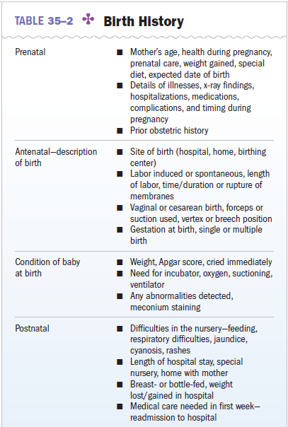

Slide 26
Acute and Chronic Illnesses •
This component of the history comprises the child’s current health status.
Chronic Illnesses congenital anomalies, genetic disorders, cancer, rheumatic fever, heart disease, hypertension, obesity, diabetes, sickle cell disease, cystic fibrosis, asthma, allergies, eczema, seizure disorders, neurologic infections, tuberculosis, renal disease, depression, and anxiety disorders | Acute Illnesses respiratory infections ear infections diarrhea Vomiting dehydration.

Slide 27
Childhood Infectious Diseases •
The provider should determine if the child has had measles, mumps, rubella, varicella, pertussis, streptococcal infections, or has recently been exposed to these illnesses

Slide 28
Allergies •
All allergies to medications, food, animals, and insect bites; environmental allergies; and a history of eczema, allergic rhinitis, contact dermatitis.

Slide 29
Medications •
The provider should ask about all current prescribed or over-the-counter (OTC) medications that the child is taking.
Notes:
The term over-the-counter (OTC) refers to a medication that can be purchased without a medical prescription

Slide 30
Hospitalizations •
The date, the child’s age, and the reason for any hospitalization as well as the name of the hospital and duration of the stay should be recorded.

Slide 31
Surgeries •
The date of any surgical procedure should be recorded,
Injuries •
The date of any injury should be documented in addition to the age of the child when injured.

Slide 32
Immunizations •
The child’s immunization history should include which immunizations were received and at what age.

Slide 33
Family Medical History
Obtaining the child’s family health history is necessary to determine the health status of immediate family members and to identify and document any inherited disorders that the child may have.

Slide 34
Pain Assessment
This assessment should include a pain intensity measure. the Face Legs Activity Cry Consolability (FLACC) scale could be used.

Slide 35
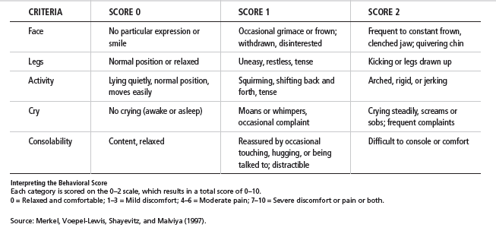

Slide 36
Nutrition
This is an important area to assess during both well and illness visits. Pediatric nutritional assessment must be tailored to the child’s age.

Slide 37
Infants.
The provider should ask if the infant is breastfed or bottle-fed and how frequently.
The provider should note whether breastfed infants are
supplemented with formula. For infants who are taking
formula, the provider should determine the type of
formula and how many ounces of formula the infant consumes per day.

Slide 38
Toddlers.
The provider should ask if the toddler drinks cow’s milk and, if so, what type (e.g., whole vs. skim) and how many ounces a day.

Slide 39
Preschoolers and School-Aged Children.
The Provider should ask the child and parent to describe
a typical meal, the child’s favorite food, and a typical
snack.

Slide 40
Adolescents. Providers should ask adolescents to
describe typical meals and snacks and the frequency
with which they consume fast food and soda. With the
parent out of the room, providers should ask adolescent
patients if they are satisfied with their body image or
if they view themselves as fat.

Slide 41
Physical Activity
The provider should ask about the number of hours the child spends each day watching television, playing video games, or using the computer.

Slide 42
Elimination
Newborns and Infants. For newborns, the provider should ask about number of wet diapers a day (six to eight are normal),.
Toddlers and Preschoolers. Renal function is not fully developed until age 2 years. Toddlers and preschoolers urinate 8 to 14 times a day ,the number of stools a day varies, according to the child’s diet; one to three stools a day is usual but one stool every 3 to 4 days is within normal limits.

Slide 43
School-Aged Children. School-aged children should
be fully toilet trained. The provider should continue to
ask about the number of voids a day (usually five to
six, depending on fluid intake) and whether the child
remains dry through the night (nocturnal enuresis is
within normal limits until the age of 5–6 years).
The frequency of stools should be assessed (normal
ranges from one to three a day, to one stool every
2–3 days).

Slide 44
Adolescents: It is also important to ask about urinary frequency or urgency, which may indicate either urinary tract or sexually transmitted infections. Polyuria in this age group can be a sign of type 1 diabetes. Frequent or chronic diarrhea may indicate laxative use.

Slide 45
Safety
assessing the safety of the environment of an infant, child, or adolescent is extremely important, and the areas of assessment vary according to age and developmental level.

Slide 46
Sleep
infants should be placed in the supine position for naps and at bedtime because of the association of sudden infant death syndrome (SIDS) with a prone sleep position.

Slide 47
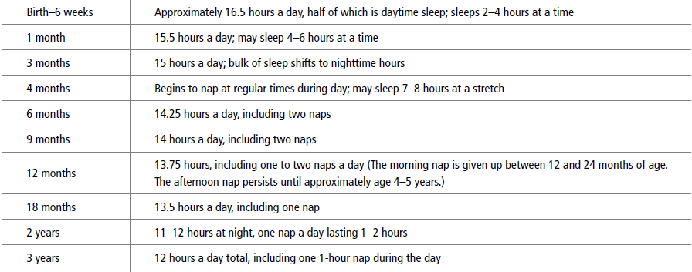
Sleep Needs of Infants and Children

Slide 48
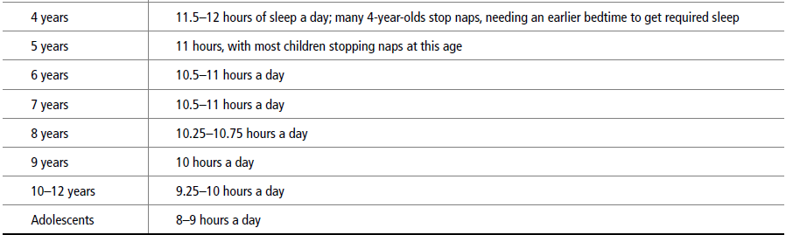

Slide 49
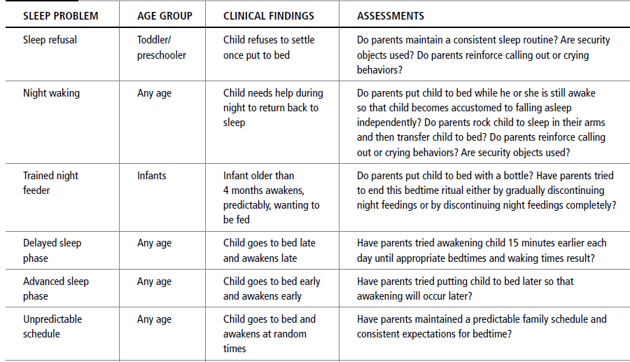
Common Pediatric Sleep Problems

Slide 50
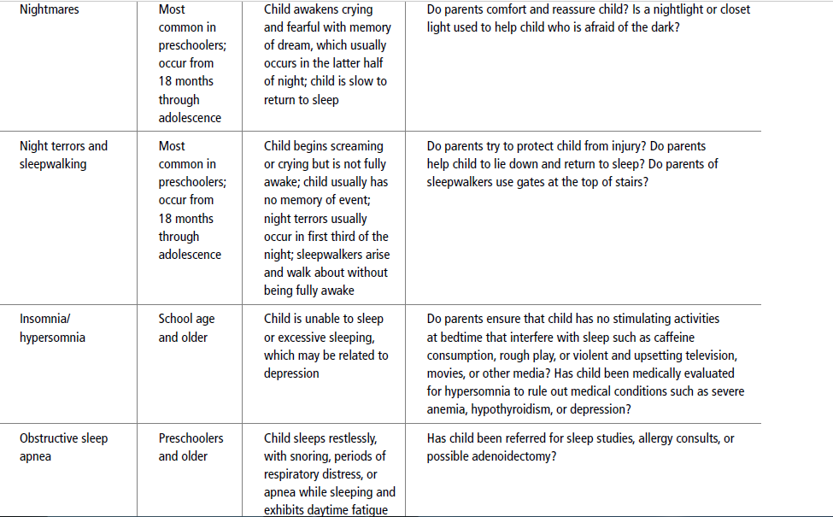

Slide 51
Social History
Family.
Home Environment.
Economic Status.
Immigrant Status.
Emergency Room Use.

Slide 52
Growth and Development
A complete history of a child’s growth and development entails determining achievement of developmental milestones in the areas of physical growth, gross and fine motor development, cognitive abilities, language development, social interaction, behavior, and temperament.
Gross motor milestones.
Fine motor milestones.
Language milestones.
Psychosocial development.

Slide 53
Gross motor milestones can be assessed by asking about infant head control, rolling over, sitting and standing without support, crawling, walking, and dressing.

Slide 54
Fine motor milestones can be assessed by exploring areas such as reaching for objects, achievement of a pincer grasp, self-feeding.

Slide 55
Language milestones can be assessed by asking about when the child spoke his or her first word with meaning, combined two to three words, and spoke in sentences.

Slide 56
Psychosocial development can be assessed by asking
the parent about the child’s temperament, play, attachment to and ability to separate from the primary caregiver, self-care abilities, peer relationships, and school performance.

Slide 57
Spiritual History
It is important for the health care provider to conduct a
spiritual assessment as part of the initial health history.

Slide 58
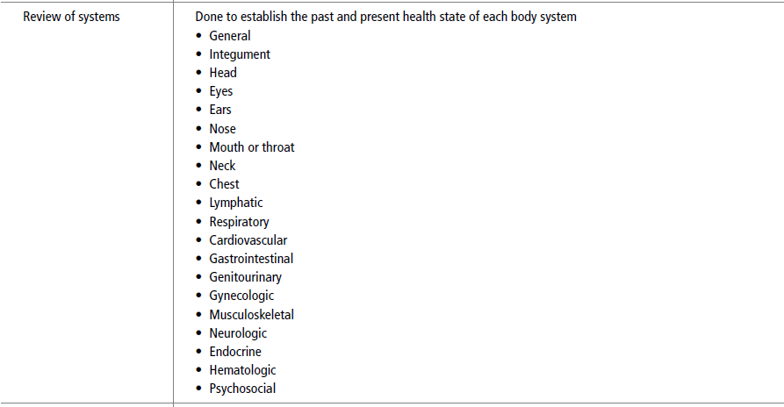
Review of systems:

Slide 59

Thank you
هذه الصورة بواسطة كاتب غير معروف مرخصة بالاسم CC BY

